Slide 1
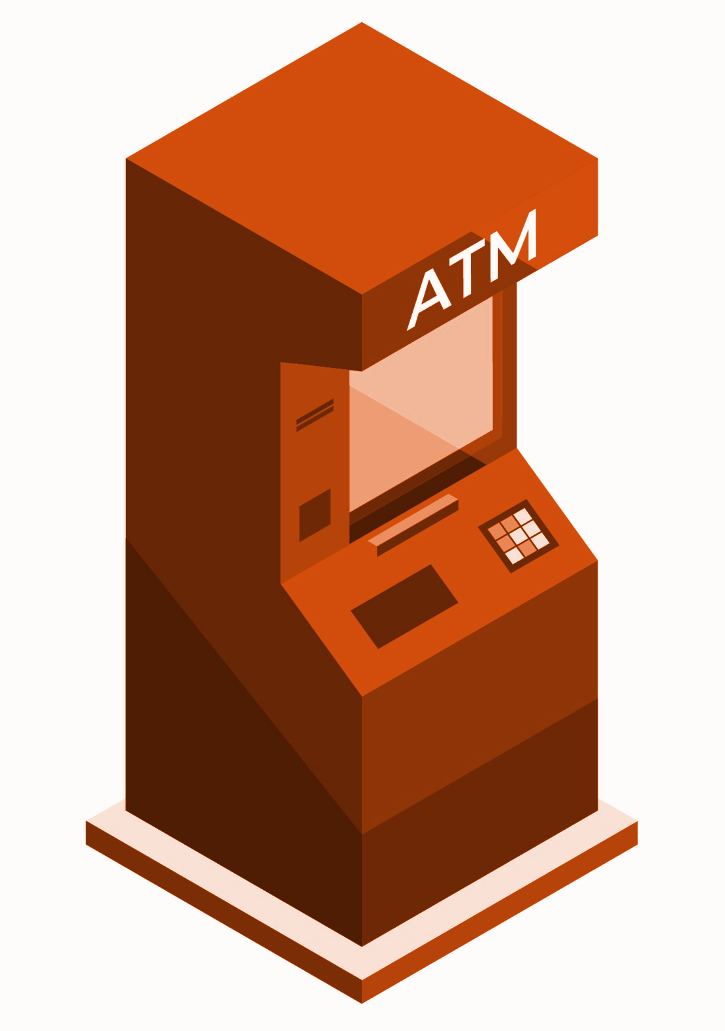
Fingerprint ATM
Software Engineering (COMP433)

Slide 2



Team Members
Ibrahim Nobani
Osama Rihami
Mahmoud Qaisi

Slide 3
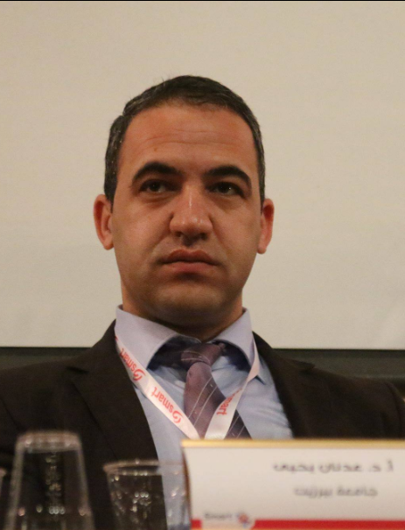

Supervised By:
Dr-Mohammed Adnan Moreb

Slide 4
Table of contents
01.
02.
03.
Business overview
Group Formation and project plan
Requirement Engineering
04.
05.
Requirement Analysis
System Modeling & Design
Purpose, Background, Scope and Motivation
Group Member Roles and followed strategy
Func. and non-Func. user Req., System Req. and effort and time estimation
You can describe the topic of the section here
System Component and architectural Design, System Deployment.

Slide 5
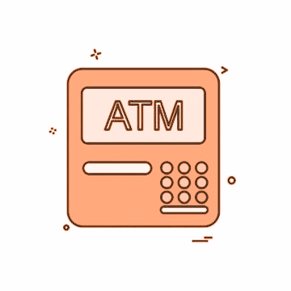
Business overview
01
Purpose, Background, Scope and Motivation

Slide 6
Our purpose
To Create a Better ATM for you security…

Slide 7
Background
Most of people nowadays depend on the ATM machine as their primary tool to make most of their bank account transactions like withdraw or deposit, and a lot of them consider using the ATM as a necessarily part of the day. working to develop and enhance these machines is a great concern to many researchers, in order to increase the efficiency and the security for the user and also for the bank.

Slide 8
Scope:
Banks in Palestine
Primarily, this ATM system targets the Banks the in Palestine. It focuses on the banks, the stakeholders and users

Slide 9
Motivation:
Fraud
More Protection
Credit card fraud is a type of identity theft that occurs when someone that is not you uses your credit card or account information for an unauthorized charge.
To solve this problem we have to replace the credit card, in another way that is safer against identity theft, and proposing the idea of using the fingerprint can provide this in addition to some other features such as solving the problem of forgetting the card.

Slide 10
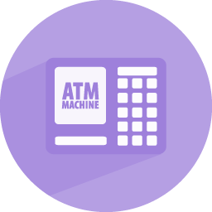
Group Formation and project plan
02
Group Member Roles and followed strategy.

Slide 11
Role Distribution
Osama
Ibrahim
Project Manager
Technical Architect
Mahmoud
Programmer

Slide 12
Management Strategy
Meetings
Process Model
Decision Making
Twice a week meetings.
WaterFall Model
Discussion and voting

Slide 13
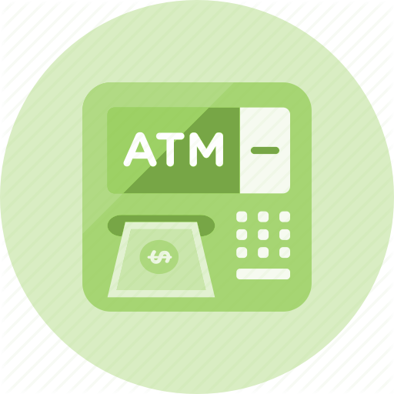
Requirement Engineering
03
Func. and non-Func. user Req., System Req. and effort and time estimation

Slide 14
User Requirements:
Functional
Non-Functional

Slide 15
System Requirments
Fast
Secure
Reliable
Efficient

Slide 16
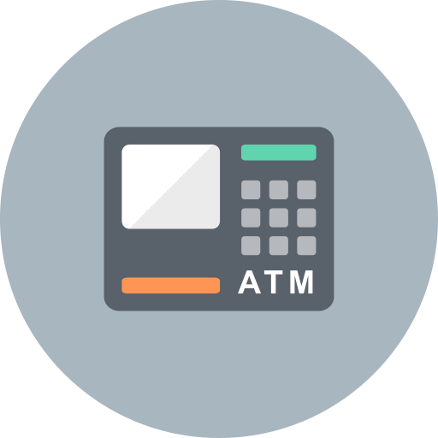
Requirements Analysis and Modelling
04

Slide 17
Actor Analysis
Actor: | Description
The Customer. | The person who uses the ATM.
The Bank System. | Represents the software in the atm that performs all the transactions and manages the data base of the bank.

Slide 18
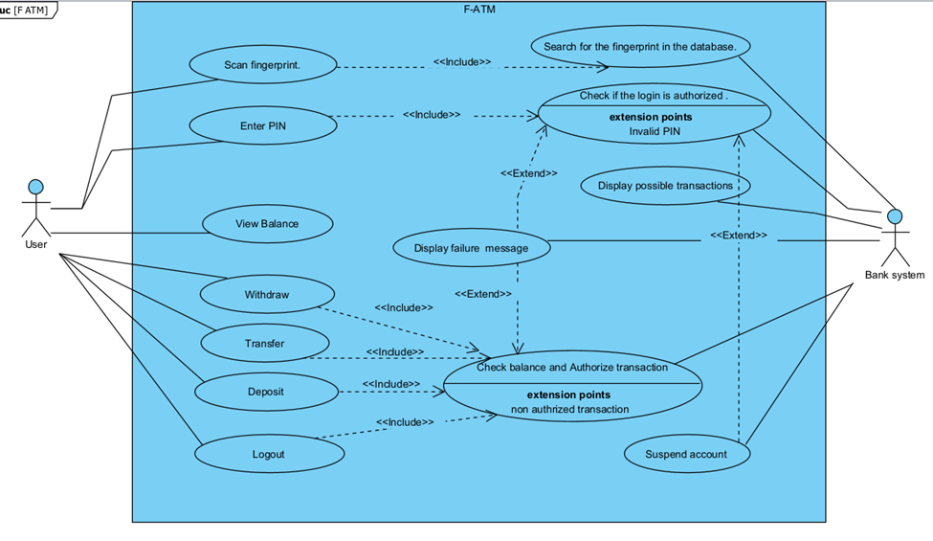
Use Case Modeling

Slide 19
Scenario Analysis : Example 1
o Scenario for Log in Process: (Author: Osama Rimawi)
Initial assumption: The user wants to use the ATM to login to his account by using his fingerprint.
Normal: At first, the user choose the login option on the screen ,then the system will ask for his fingerprint ,the user will place his finger on the fingerprint scanner ,after the scan is done the system will take the fingerprint information and search for it in the database , if it finds an account that matches that data ,the screen will ask for the PIN code for this account that the user will write on the keyboard pad, if the PIN is correct, the system displays a list of possible transactions that user can perform on the ATM screen.
Alternative: If the ATM scans the user’s fingerprint, and the fingerprint information does not exist in the database, the system will display a fault message that “the system can’t recognize the fingerprint entered”, and it will ask the user try again.
Error: If the user tries to login to his account and he entered an incorrect PIN code in the ATM, the system will display a fault message that “Wrong PIN code”, then the system will ask the user to try again, and if the user entered a wrong PIN again for more than three consecutive times, the system will suspend the user account and will display a fault message that “user has tried to access the account so many times so the account is now suspended”.

Slide 20
Scenario Analysis : Example 2
o Scenario for Deposit transaction: (Author: Ibrahim Nobani)
Initial assumption: The user wishes to deposit cash into his bank account. The customer approaches the ATM machine, scans his fingerprint and then logs into his account.
Normal: The customer checks the main menu and chooses the deposit option, the cash dispenser then opens and customer puts the amount of cash he wishes to insert into his account inside the dispenser, after the cash is inserted the dispenser closes, the cash entered is scanned and displayed on screen, the user verified if the value is correct, the account is the updated and the system returns to the main menu.
Alternative: The customer wants to cancel the deposit transaction; the dispenser opens and the customer reclaims his cash. Error: If the value displayed on the screen is not equal to the value put in the dispenser, the dispenser opens up to return the cash back to the user, the system returns to the main menu.

Slide 21
Scenario Analysis : Example 3
o Scenario for Transfer transaction: (Author: Mahmoud Qaisi)
Initial Assumption: The customer has a working active account in the bank that owns the atm. The customer has logged into his account successfully. And wishes to transfer an amount of money to another account.
Normal: The user chooses transfer option from the main menu. The system will ask the user to provide the account number that he wishes to transfer to. The system will validate the account no. to make sure it’s an active account that exists. Then the system will request the amount the user wishes to transfer. The system will check if the user’s account has sufficient funds to cover the transfer. Then the system will display a summary message. Then the user should confirm the transfer. Then a success message is displayed and the balance of the user’s account is updated.
Alternative: If the user doesn’t confirm the transfer the transaction is canceled and the atm returns to the atm menu.
Error:
· If the user provides an account number of an account that is inactive or an account doesn’t exist. An error message is displayed and the user is asked to enter a valid account number to be checked again. Or the user can abandon the whole transfer and will be returned to the main menu.
· If the balance of the user’s account doesn’t have enough funds to cover the transfer for the amount he specified. An error message is displayed then the user is asked to enter a new amount to transfer or the user can cancel the transfer and return to main menu.

Slide 22
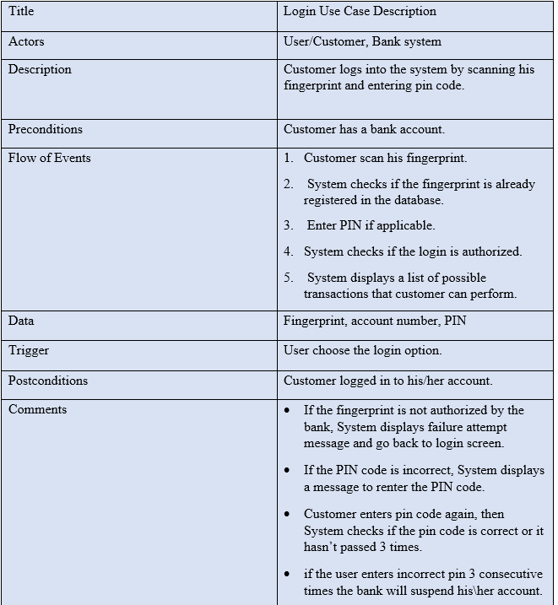
Use Case Specification: Example 1

Slide 23
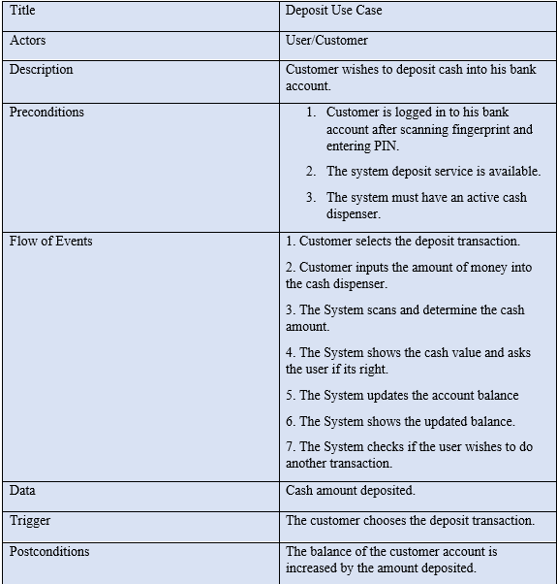
Use Case Specification: Example 2

Slide 24
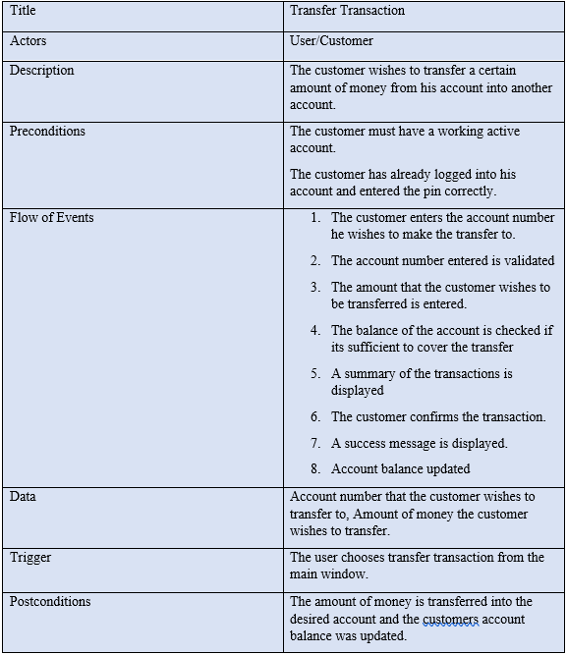
Use Case Specification: Example 3

Slide 25
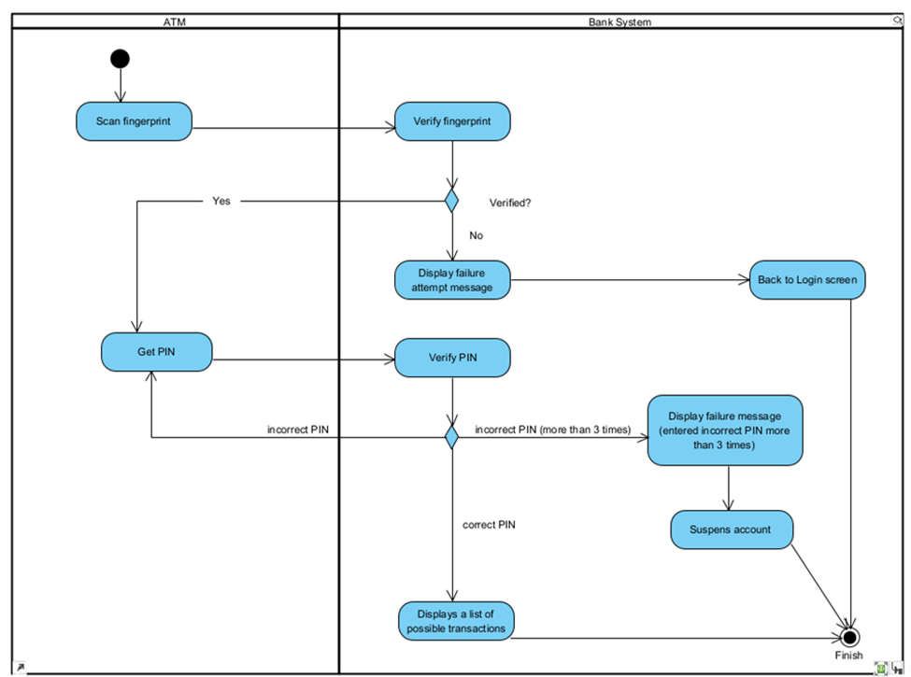
Activity Diagram: Example 1

Slide 26
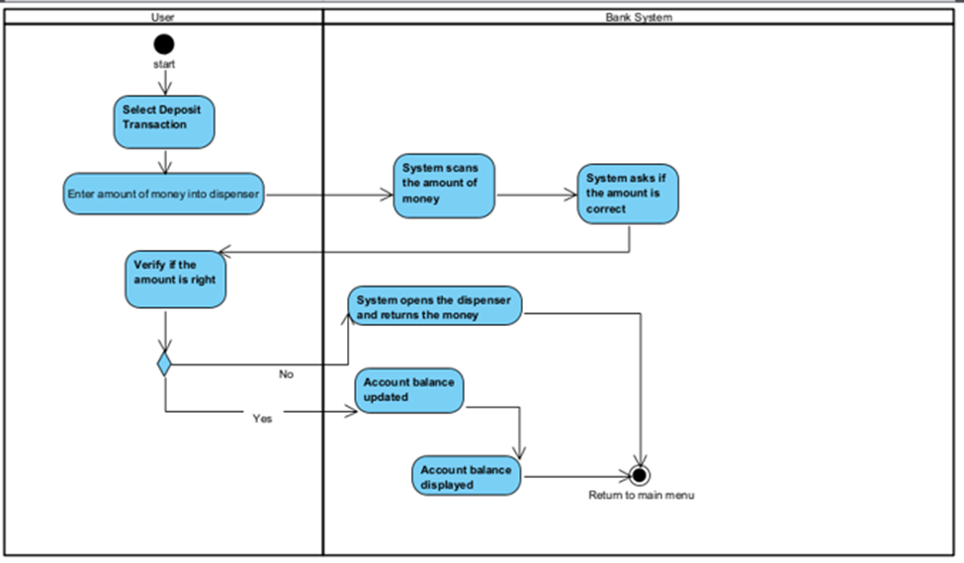
Activity Diagram: Example 2

Slide 27
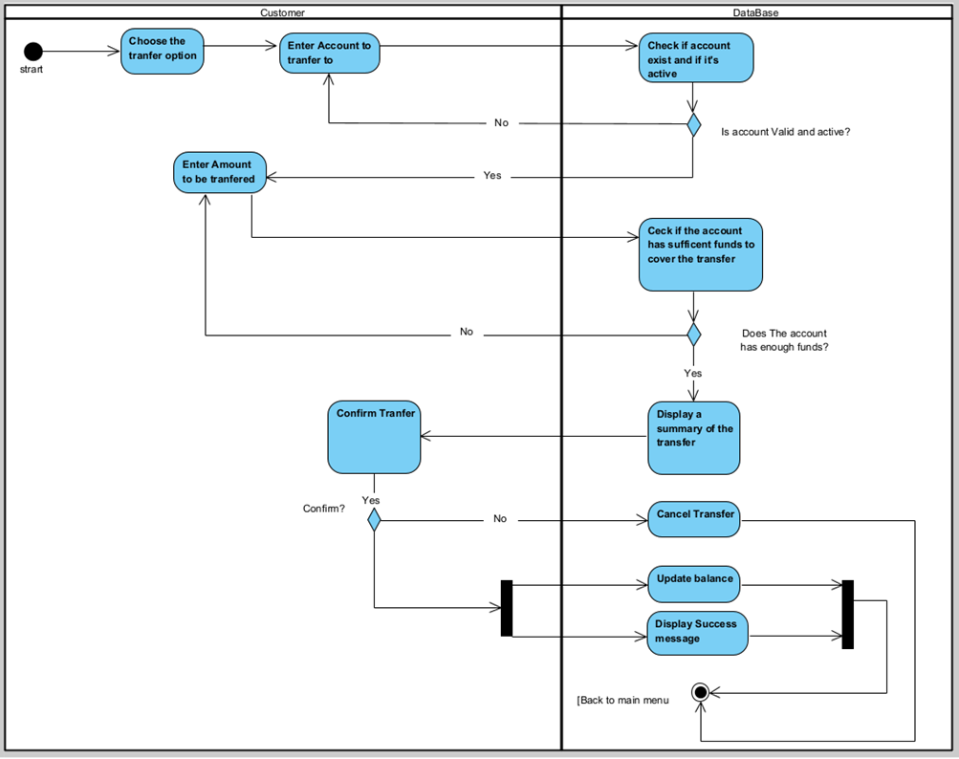
Activity Diagram: Example 3

Slide 28
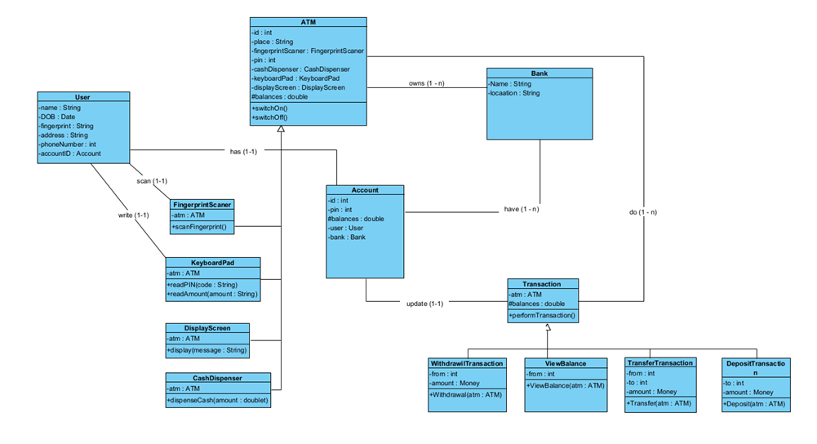
Class Diagram

Slide 29
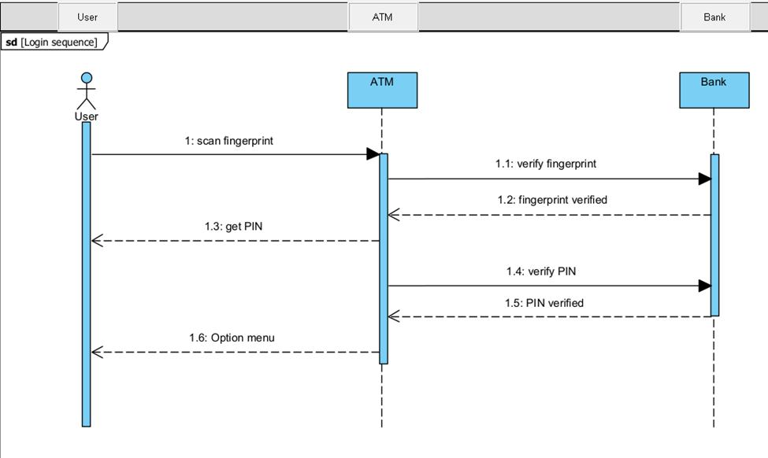
Sequence Diagram : Example 1

Slide 30
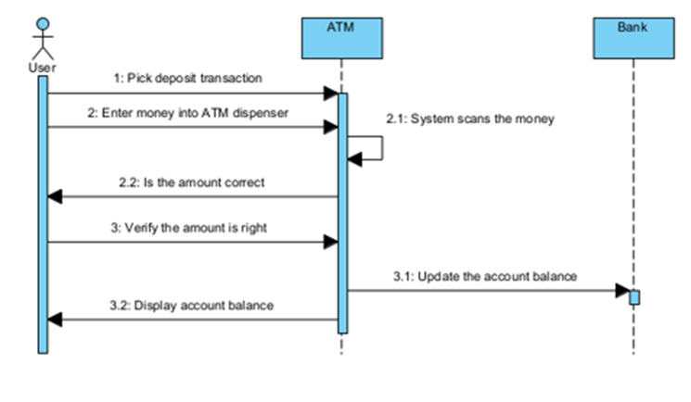
Sequence Diagram : Example 2

Slide 31
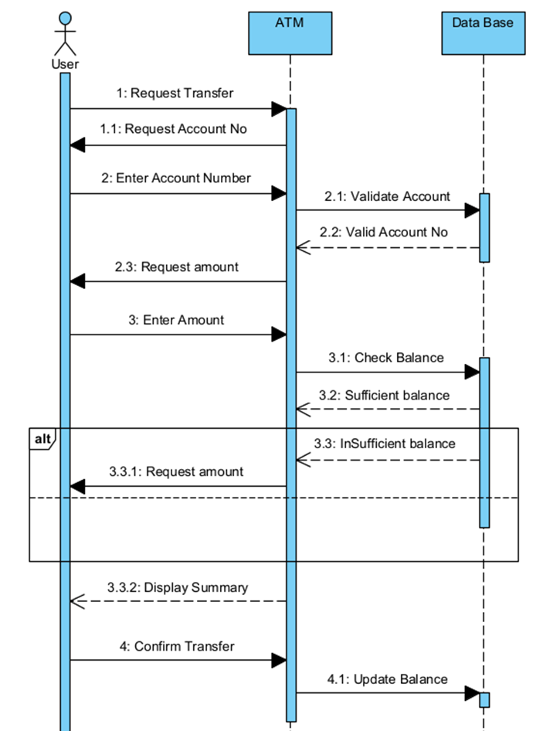
Sequence Diagram : Example 3

Slide 32
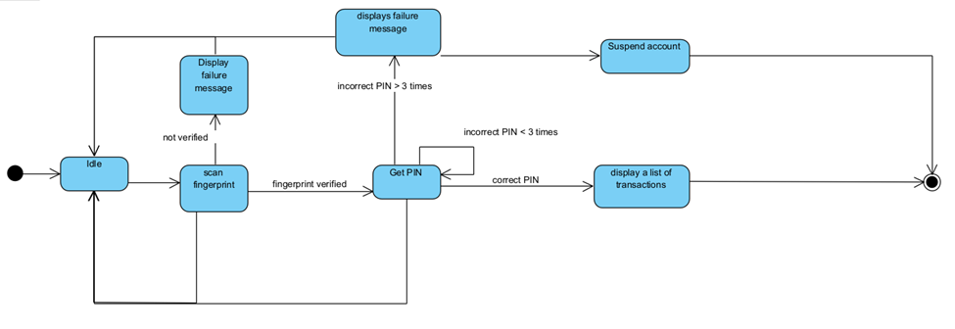
State Diagram : Example 1

Slide 33
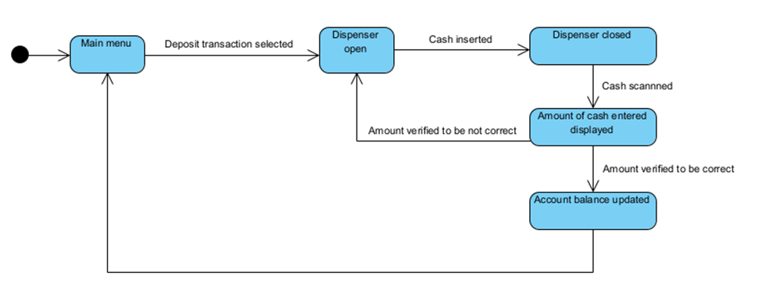
State Diagram : Example 2

Slide 34
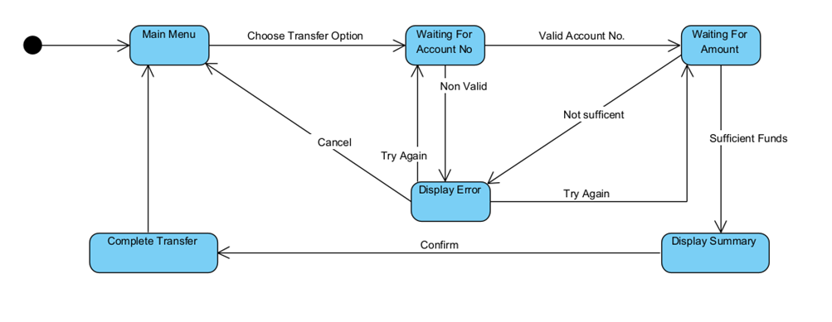
State Diagram : Example 3

Slide 35
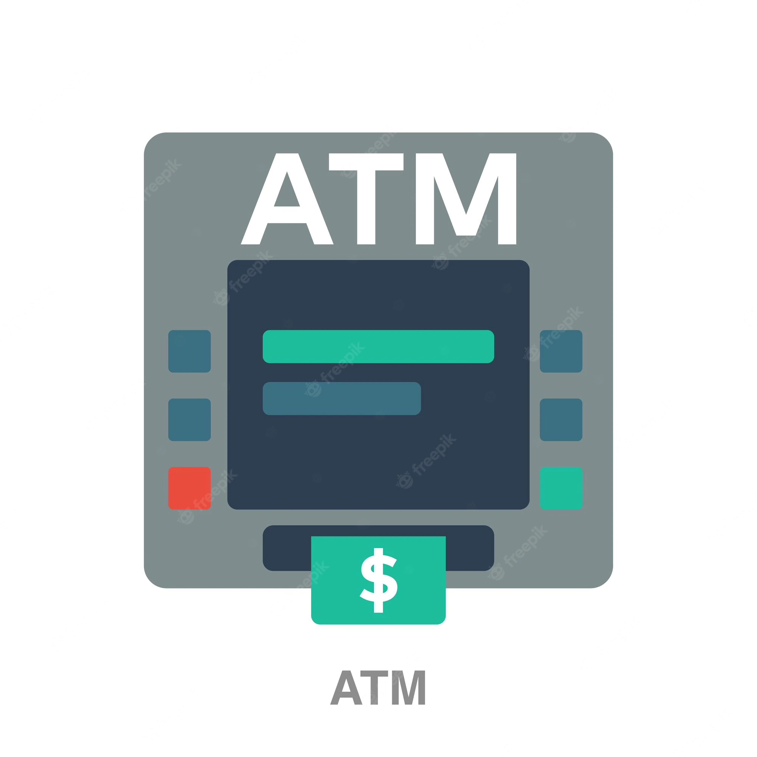
System Modelling and Design.
05
You can enter a subtitle here if you need it

Slide 36
4.1. System Design Goals
01
02
03
04
Methods and classes related with each other were kept together as a single component. For example, transaction includes deposit, withdrawal, transfer.
High Cohesion
Low Coupling
Reliability
Persistence
Methods and classes unrelated to each other were separated as much as possible, operations on the cash dispenser (like deposit and withdrawal) are not connected to the login process.
we’re dealing with a critical system so we'll always have a backup in case of any failures that might occur during any operation, also the system will return to the state before the operation.
All the transactions and changes must continuous and without any conflict such as two readings and then a writing occurs from one of the readings. Extra measures were added to the database of the bank to avoid such conflicts from happening.

Slide 37
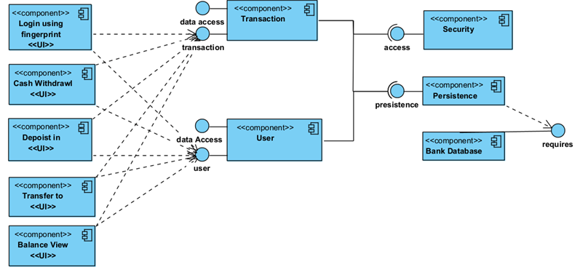
4.2: System and Component modeling.

Slide 38
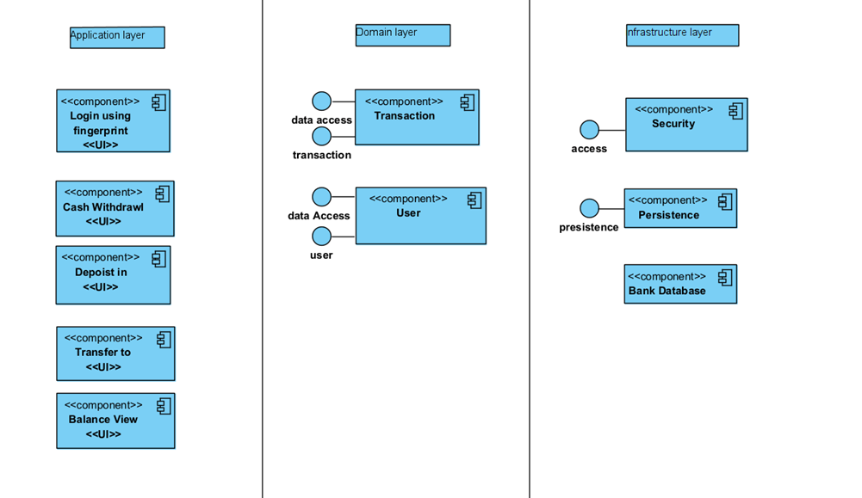
4.3: System and architectural Design

Slide 39
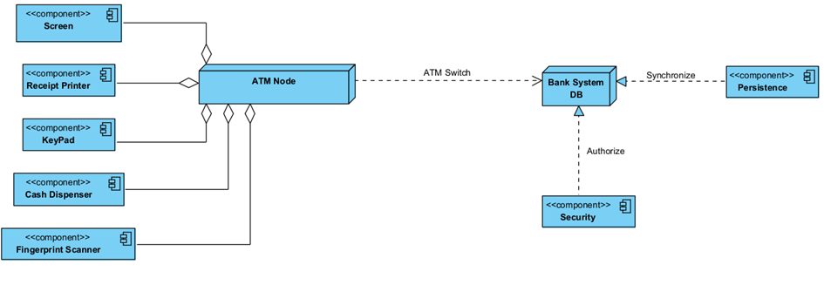
4.3: System and Deployment modeling

Slide 40
Thanks!
Do you have any questions?
Please keep this slide for attribution

